Slide 1
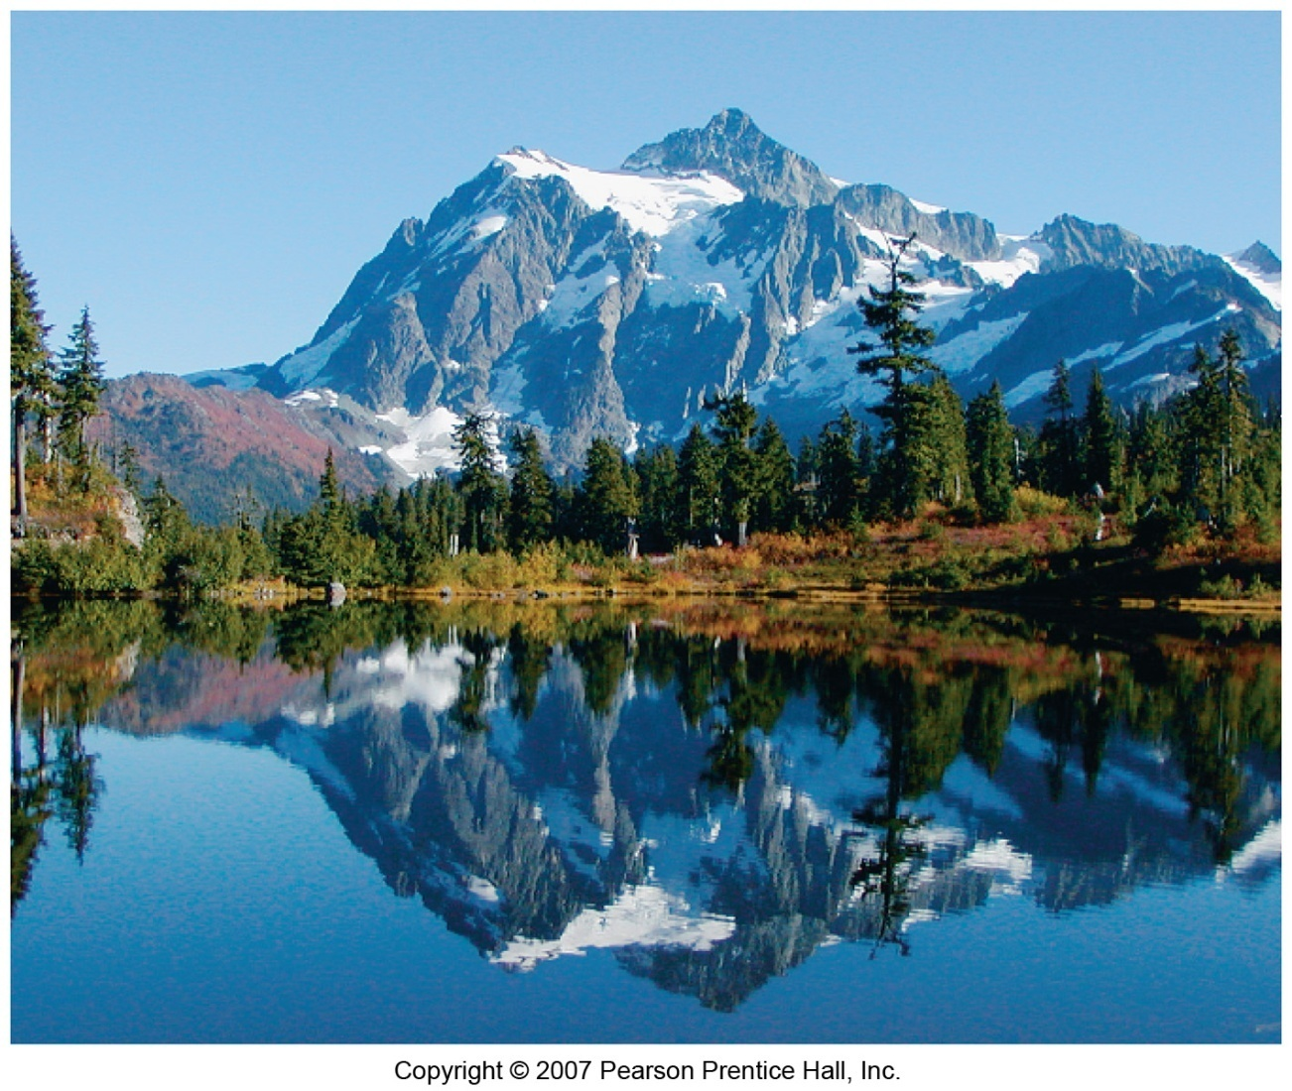
Geometrical Optics

Slide 2
Units
The Reflection of Light
Forming Images with a Plane Mirror
Spherical Mirrors
Ray Tracing and the Mirror Equation
The Refraction of Light
Ray Tracing for Lenses
The Thin-Lens Equation
Dispersion and the Rainbow

Slide 3
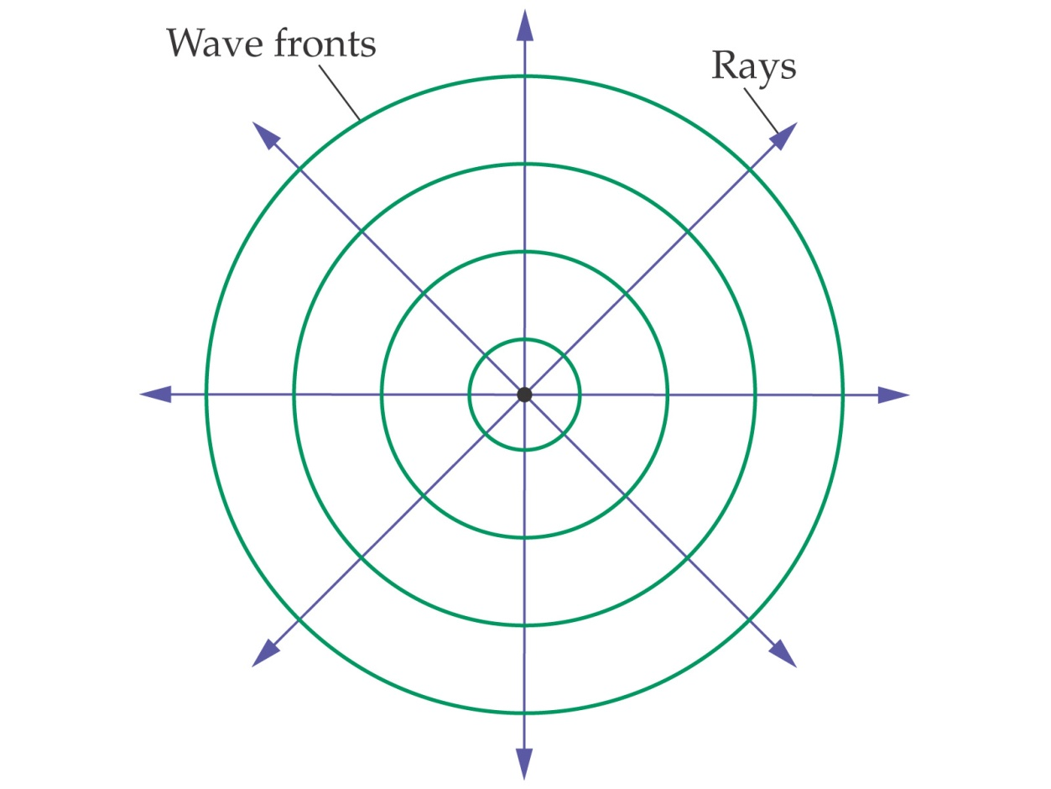
The Reflection of Light
If a stone is dropped into a pond, circular waves emanate from the point where it landed. Rays, perpendicular to the wave fronts, give the direction in which the waves propagate.

Slide 4
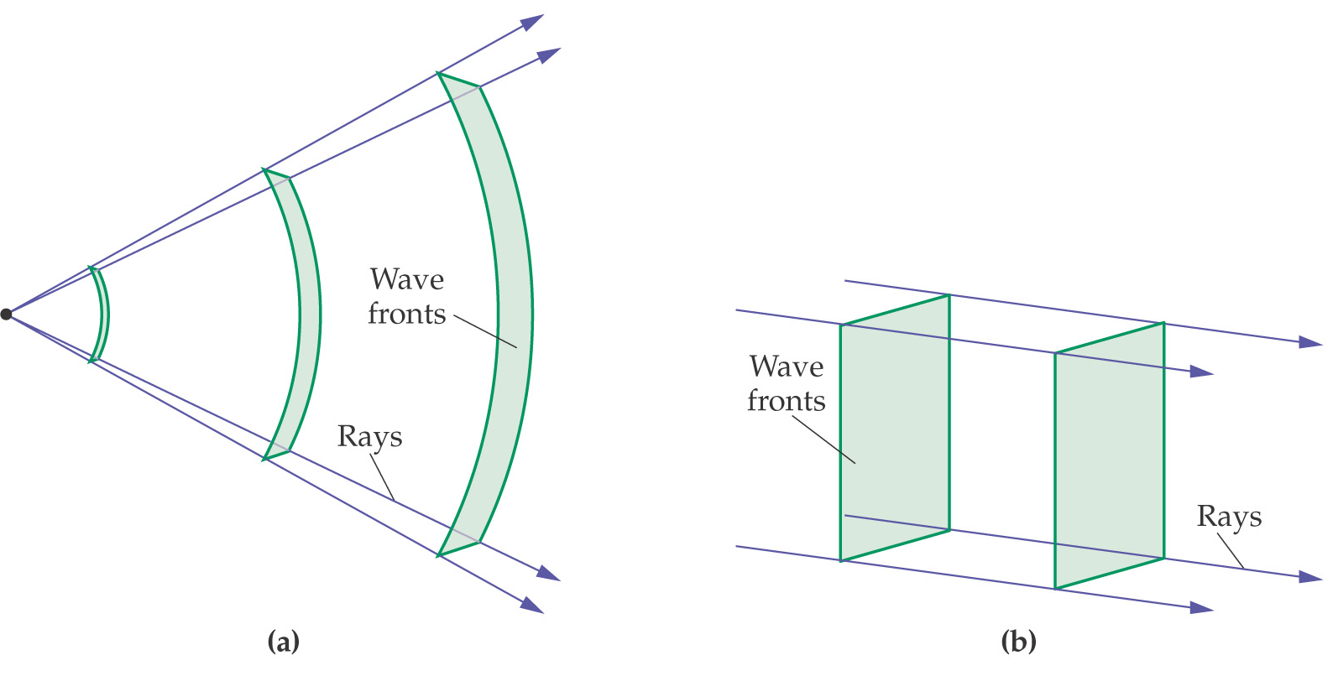
The Reflection of Light
As one moves farther from a point wave source, the wave fronts become more nearly flat and the rays become more parallel.

Slide 5
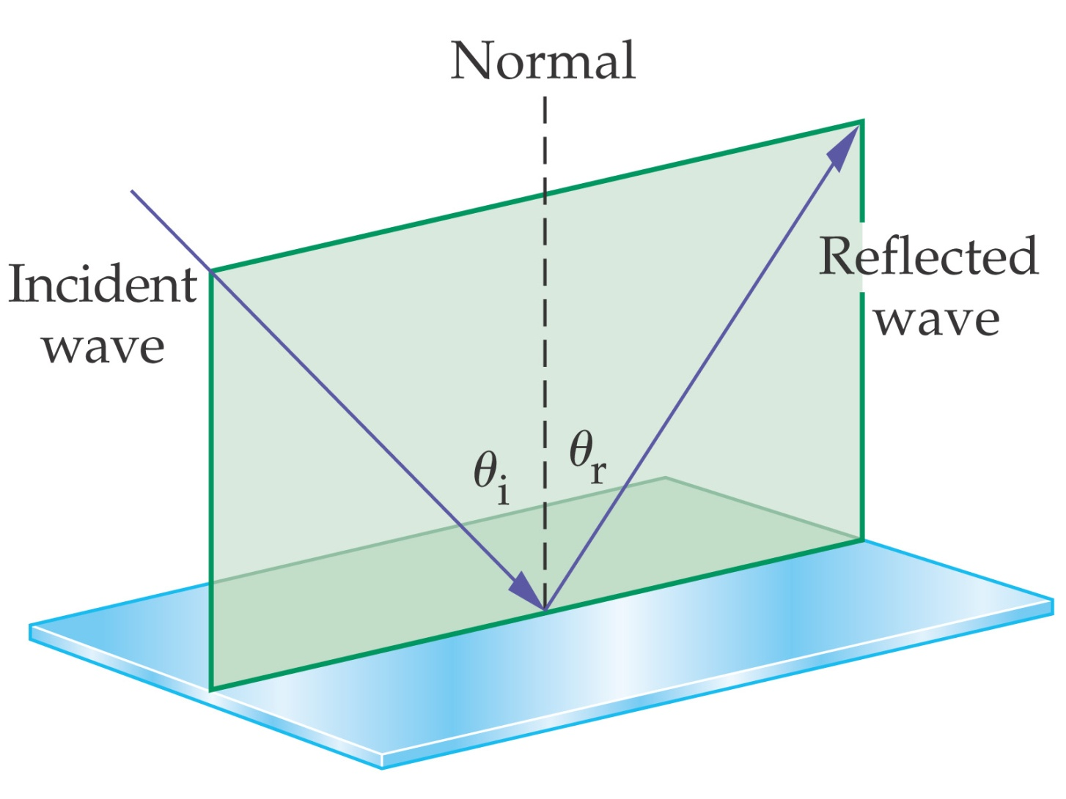
The Reflection of Light
The law of reflection states that the angle of incidence equals the angle of reflection:

Slide 6
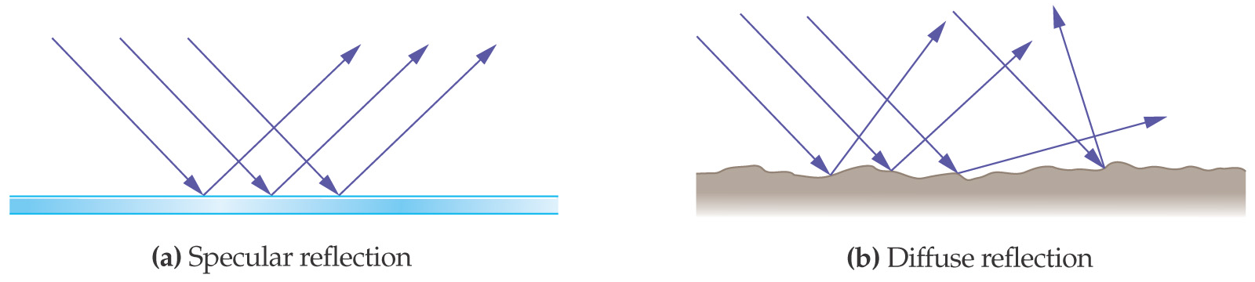
The Reflection of Light
Reflection from a smooth surface is called specular reflection; if the surface is rough, it is diffuse reflection.

Slide 7
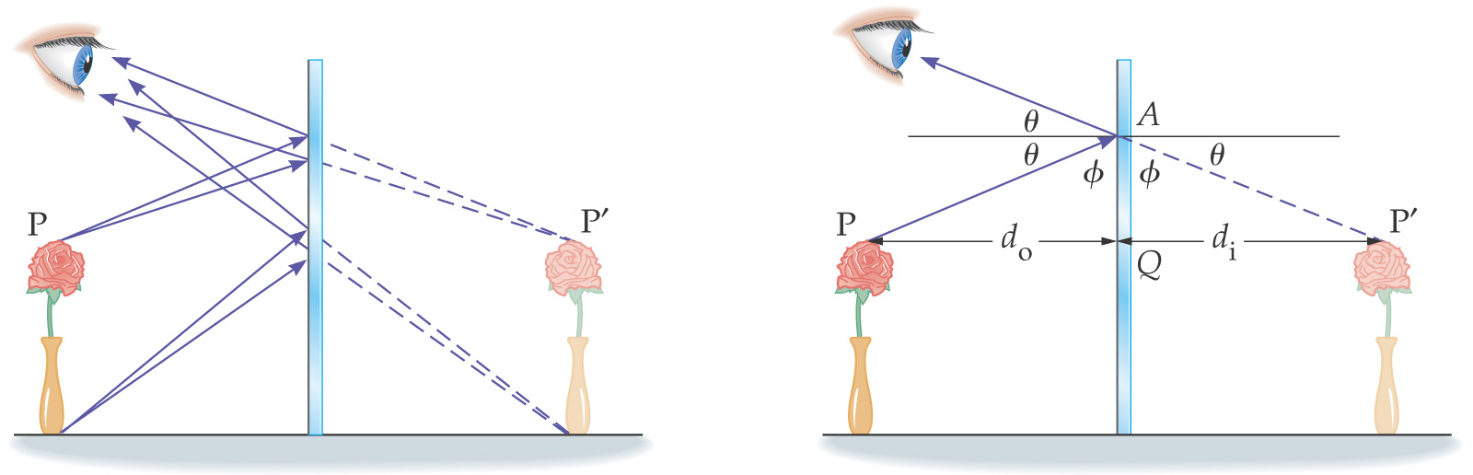
Forming Images with a Plane Mirror
Light reflected from the flower and vase hits the mirror. Obeying the law of reflection, it enters the eye. The eye interprets the ray as having had a straight-line path, and sees the image behind the mirror.

Slide 8
Forming Images with a Plane Mirror
Properties of Mirror Images Produced by Plane Mirrors:
• A mirror image is upright, but appears reversed right to left.
• A mirror image appears to be the same distance behind the mirror that the object is in front of the mirror.
• A mirror image is the same size as the object.

Slide 9
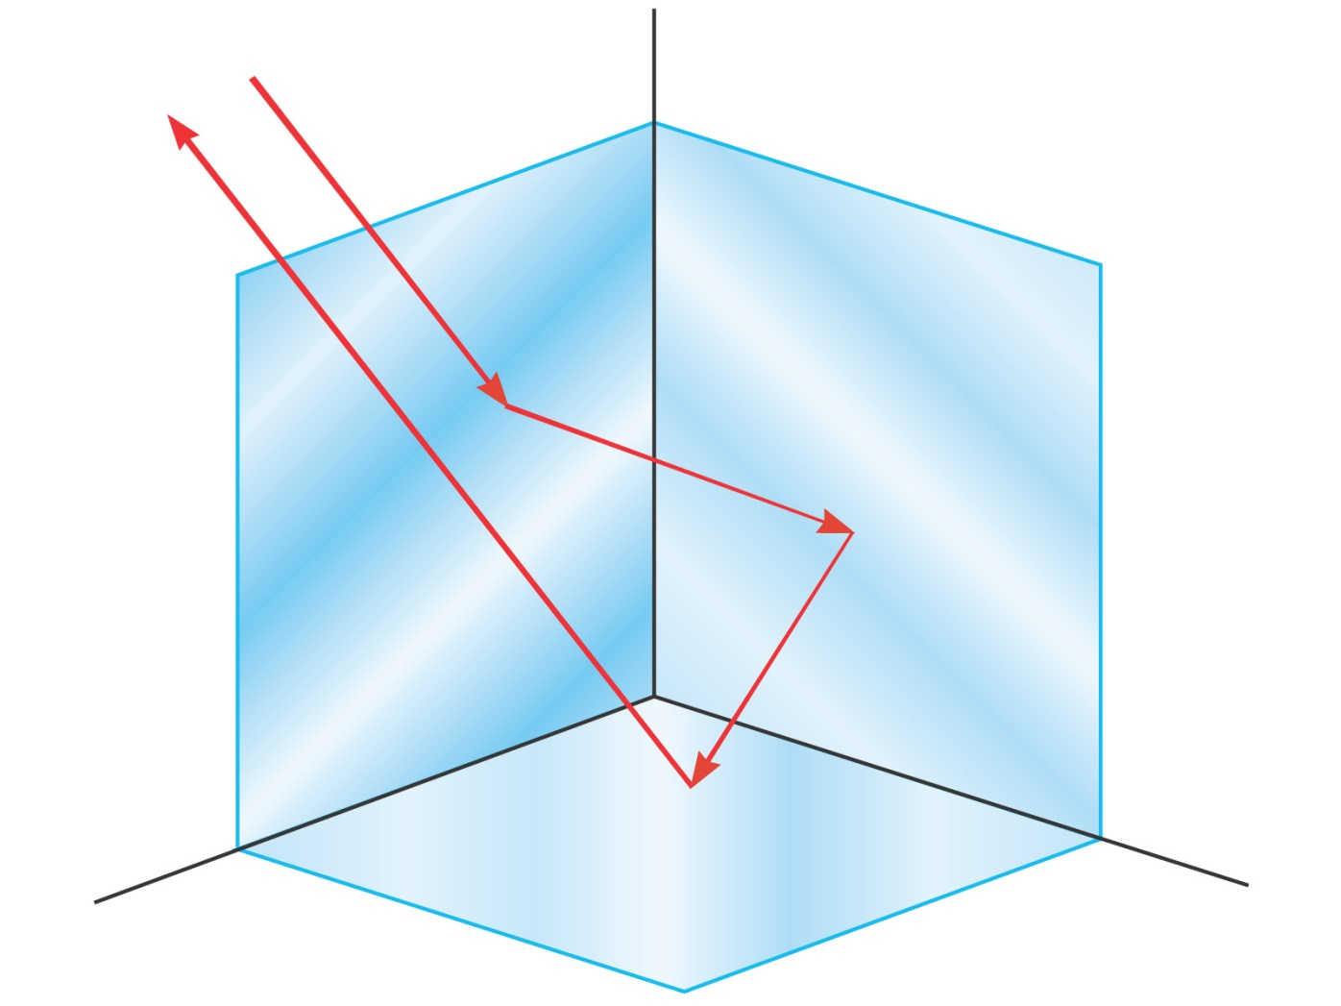
Forming Images with a Plane Mirror
A corner reflector reflects light parallel to the incident ray, no matter the incident angle.

Slide 10

Spherical Mirrors
A spherical mirror has the shape of a section of a sphere. If the outside is mirrored, it is convex; if the inside is mirrored, it is concave.

Slide 11
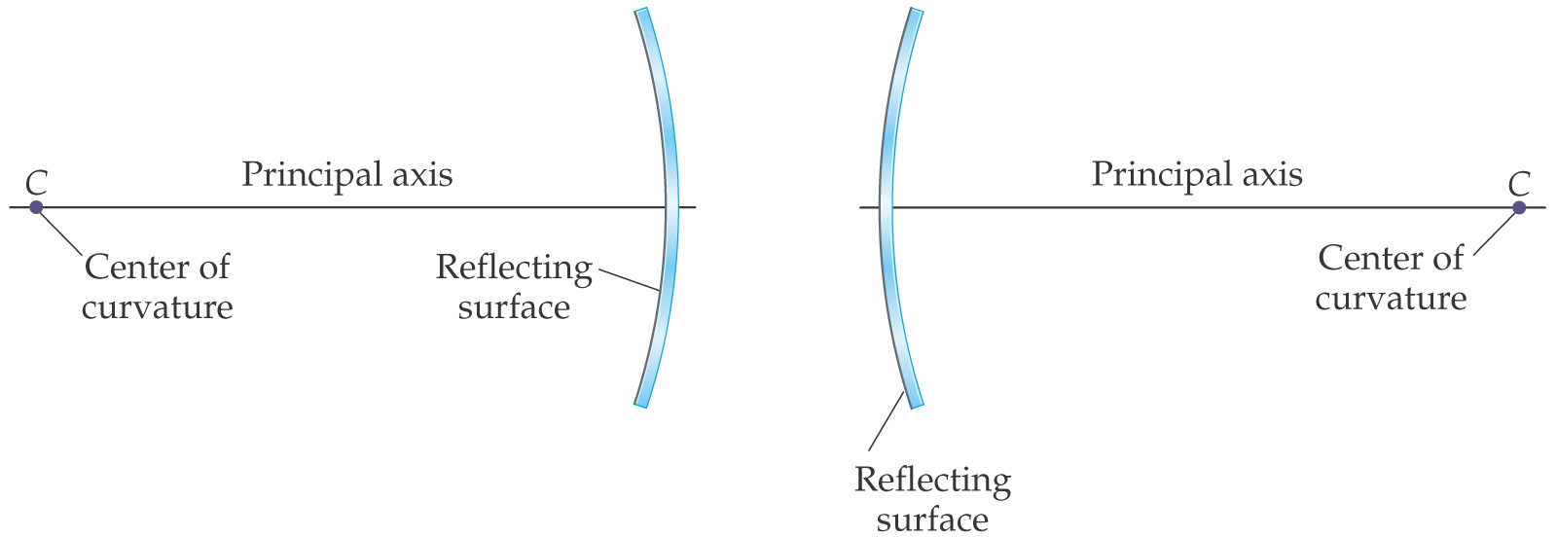
Spherical Mirrors
Spherical mirrors have a central axis (a radius of the sphere) and a center of curvature (the center point of the sphere).

Slide 12
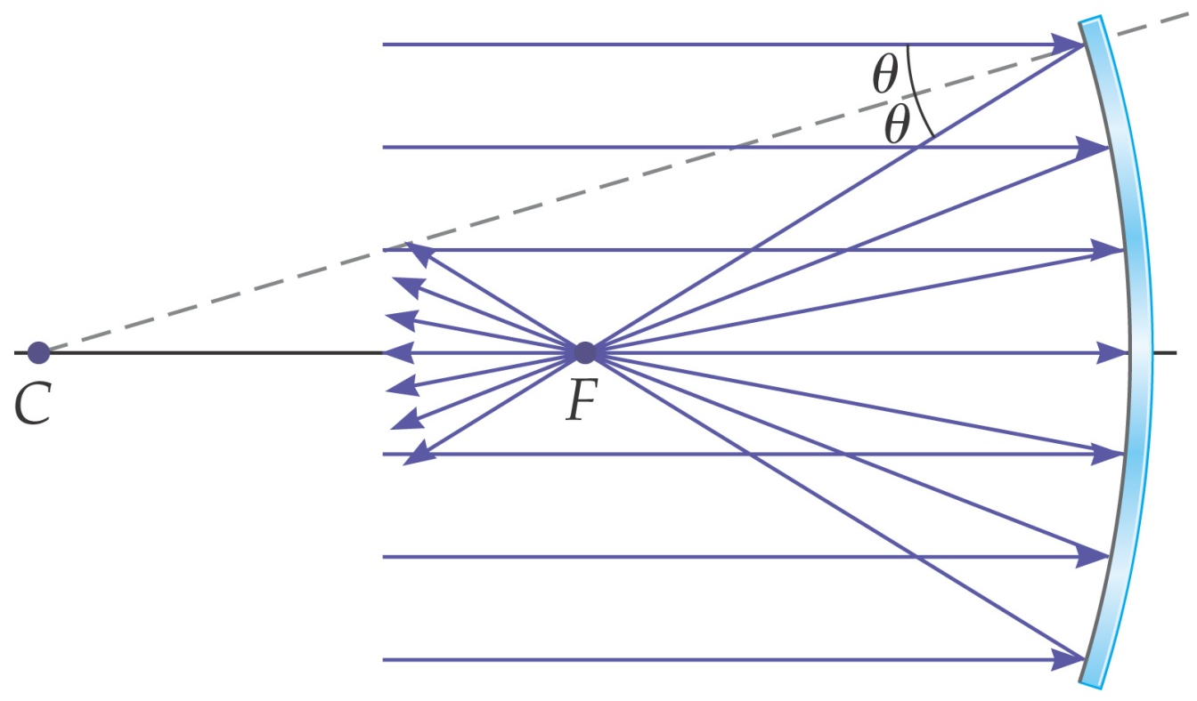
Spherical Mirrors
Parallel rays hitting a spherical mirror come together at the focal point (for concave mirrors).

Slide 13
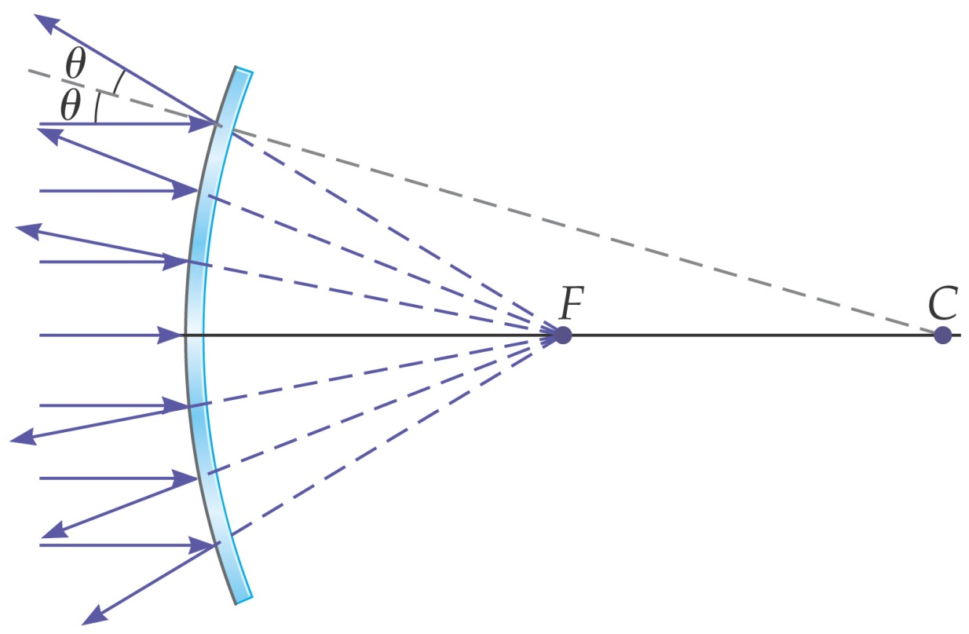
Spherical Mirrors
Parallel rays hitting a convex spherical mirror appear to have come from the focal point.

Slide 14
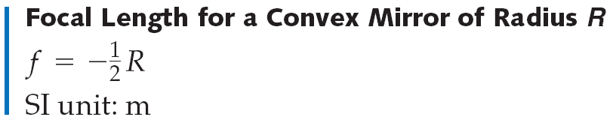
Spherical Mirrors
For a convex mirror, the focal length is negative, as the rays do not go through the focal point.
The opposite is true for a concave mirror.

Slide 15
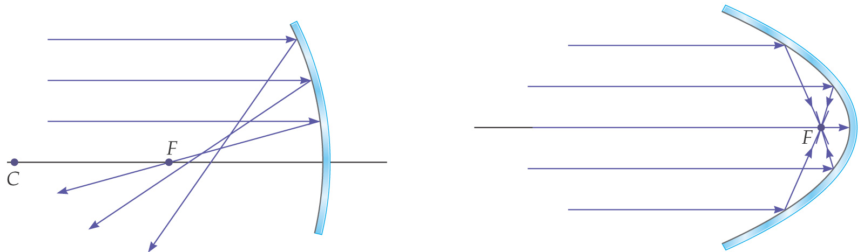
Spherical Mirrors
We have made the assumption here that the rays do not hit the mirror very far from the principal axis. If they do, the image is blurred; this is called spherical aberration, and can be remedied by using a parabolic mirror instead.

Slide 16
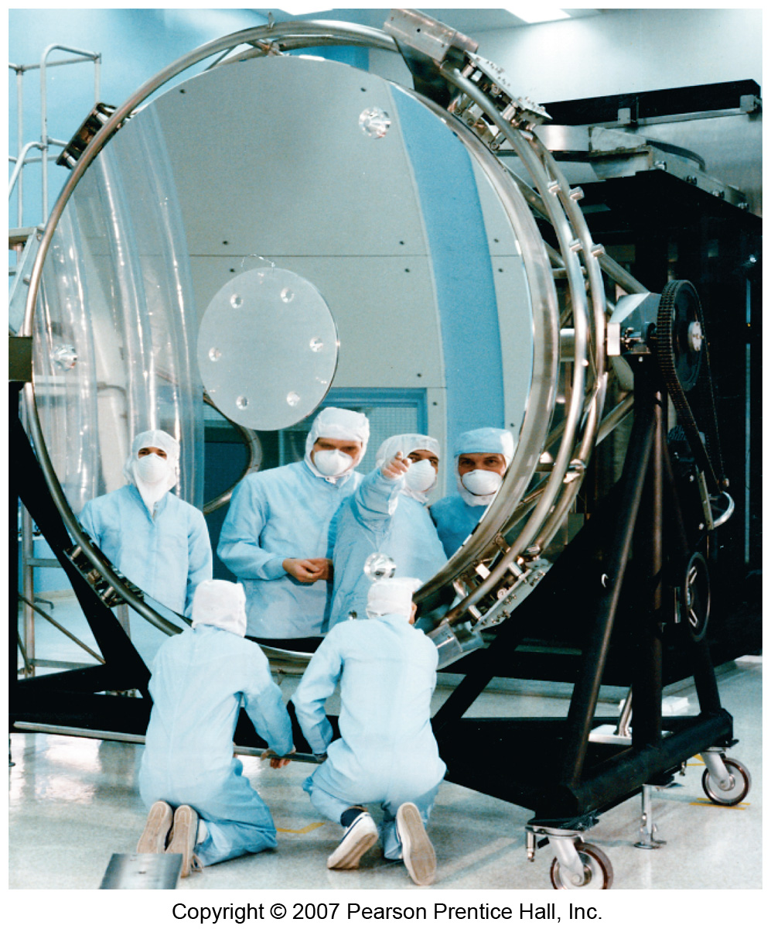
Spherical Mirrors
When the Hubble Space Telescope was first launched, its optics were marred by spherical aberration. This was fixed with corrective optics.

Slide 17
Ray Tracing and the Mirror Equation
We use three principal rays in finding the image produced by a concave mirror.
The parallel ray (P ray) reflects through the focal point.
The focal ray (F ray) reflects parallel to the axis.
The center-of-curvature ray (C ray) reflects back along its incoming path.
We will not use the C ray.

Slide 18
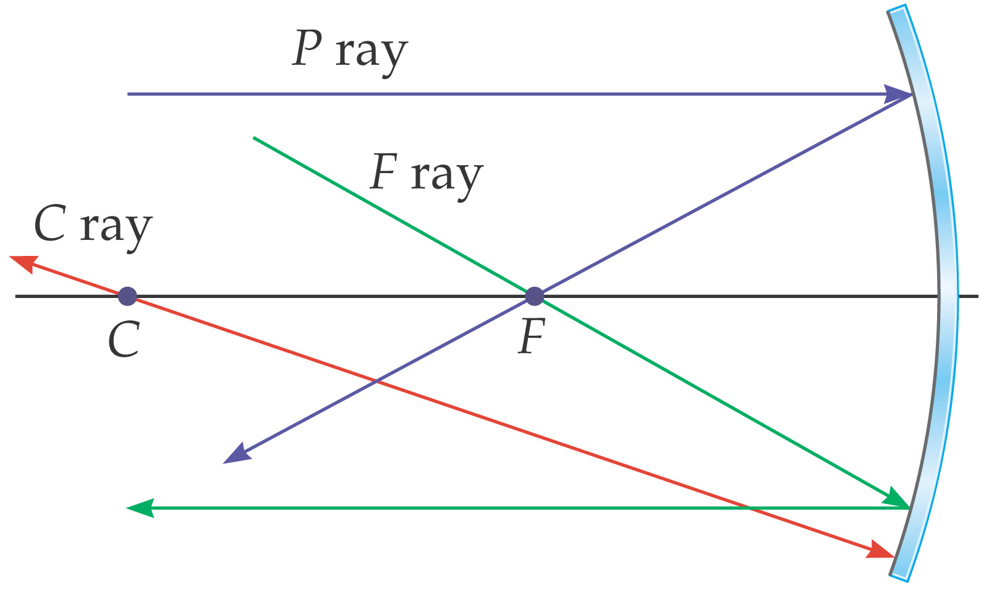
Ray Tracing and the Mirror Equation
These three rays are illustrated here.

Slide 19
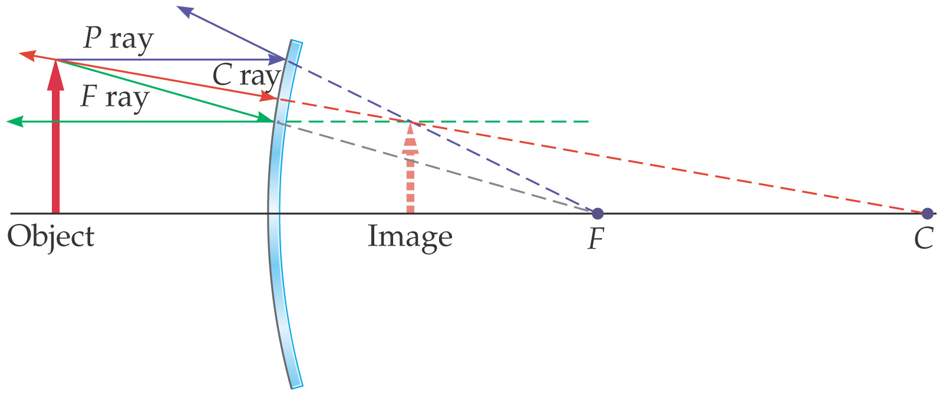
Ray Tracing and the Mirror Equation
This image shows how these three rays are used to find the image formed by a convex mirror. The image is located where the projections of the three rays cross. The size of the image can also be determined.

Slide 20
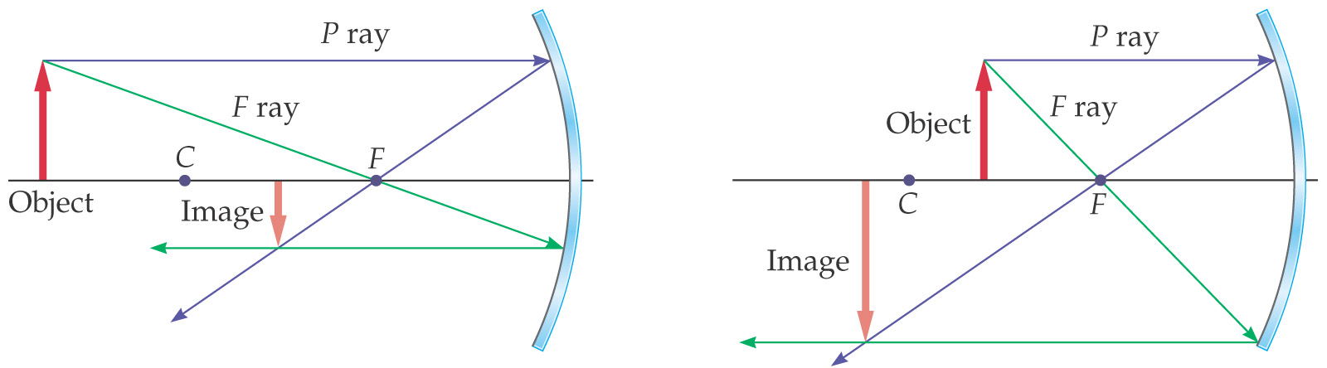
Ray Tracing and the Mirror Equation
The process is similar for a concave mirror, although there are different results depending on where the object is placed.

Slide 21
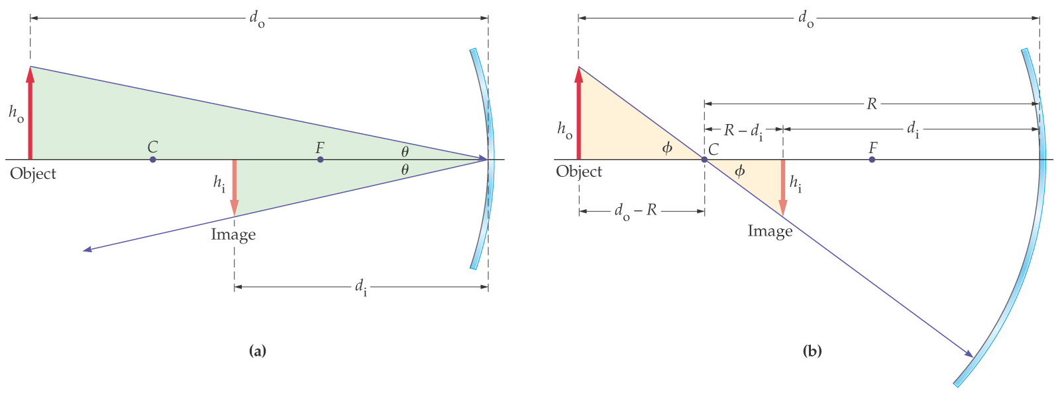
Ray Tracing and the Mirror Equation
These similar triangles are used to derive the equations that we use with mirrors.

Slide 22
Ray Tracing and the Mirror Equation
Using the similar triangles and the fact that f = ½ R, we get the mirror equation:
Here, d_{o} is the distance from the mirror to the object, d_{i} is the distance from the mirror to the image, and f is the focal length.

Slide 23
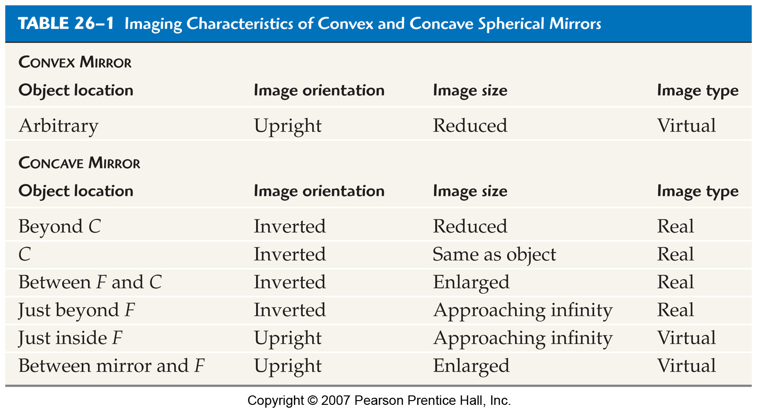
Ray Tracing and the Mirror Equation

Slide 24
Ray Tracing and the Mirror Equation
Using the similar triangles and the fact that f = ½ R, we get the mirror equation:
Here, d_{o} is the distance from the mirror to the object, d_{i} is the distance from the mirror to the image, and f is the focal length.

Slide 25
Ray Tracing and the Mirror Equation
We can also find the magnification:

Slide 26
Ray Tracing and the Mirror Equation
Here are the sign conventions for concave and convex mirrors:

Slide 27
The Refraction of Light
Thin lenses –bending light

Slide 28
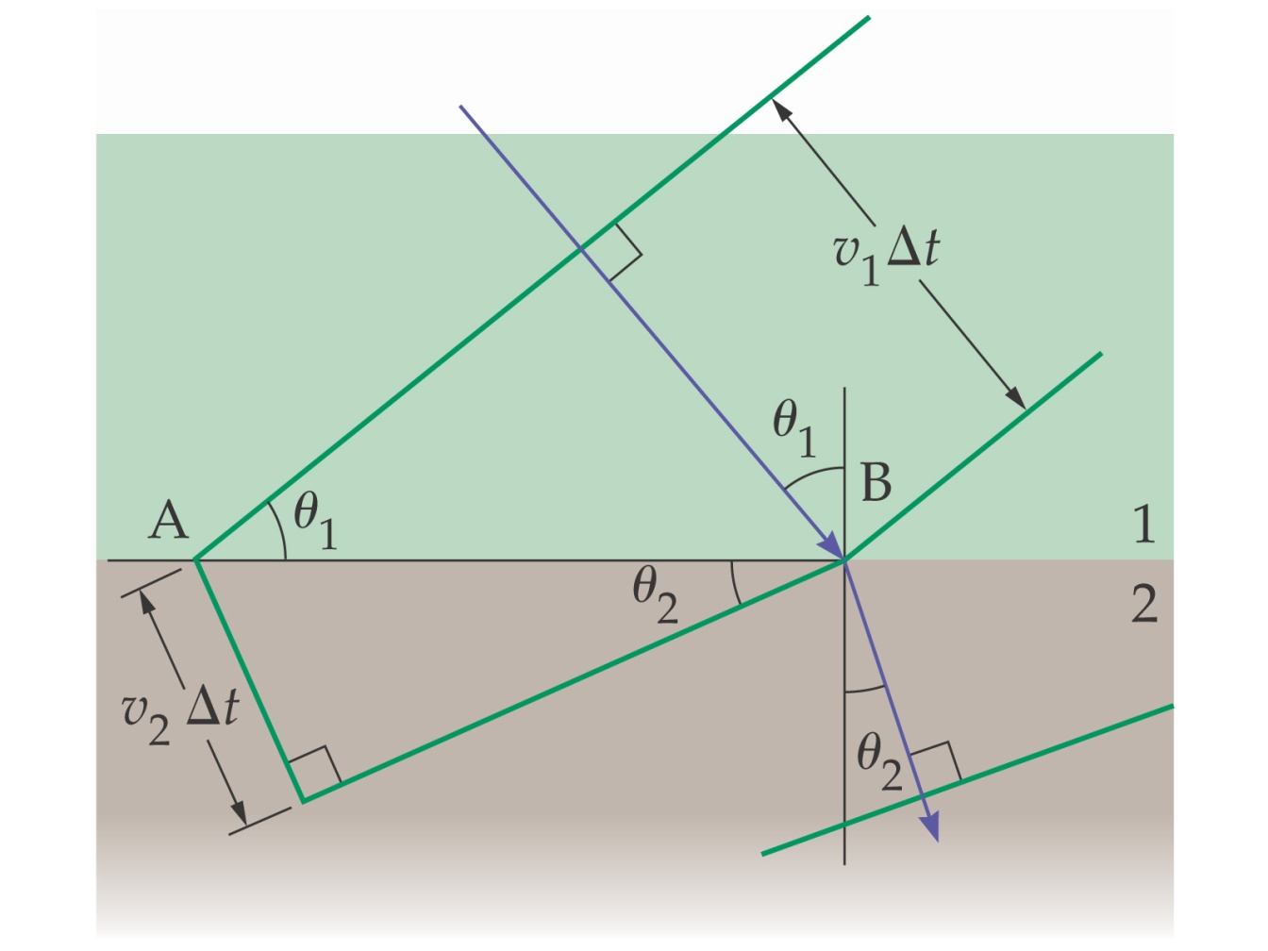
The Refraction of Light
Light moves at different speeds through different media. When it travels from one medium into another, the change in speed causes the ray to bend.
Incident light

Slide 29
The Refraction of Light
The angle of refraction is related to the different speeds:
This equation
is not needed
The speed of light in a medium is given by the index of refraction of that medium:
c- speed of light in a vacuum
v- speed of light in the medium
n- the index of refraction of the medium

Slide 30
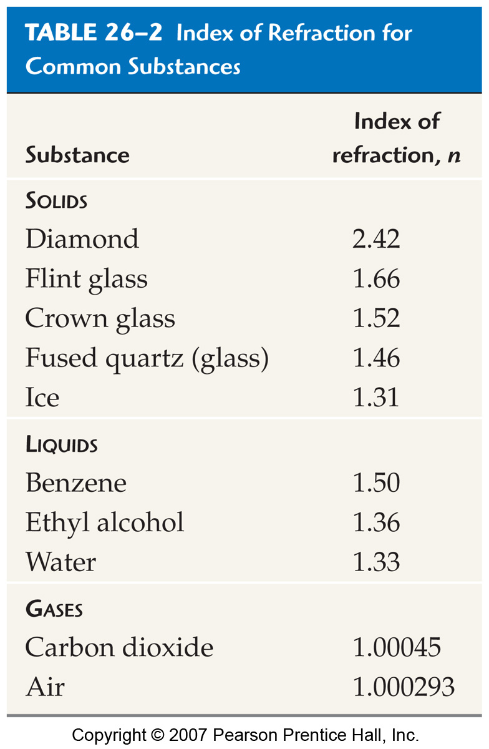
The Refraction of Light
Here are some typical indices of refraction:

Slide 31
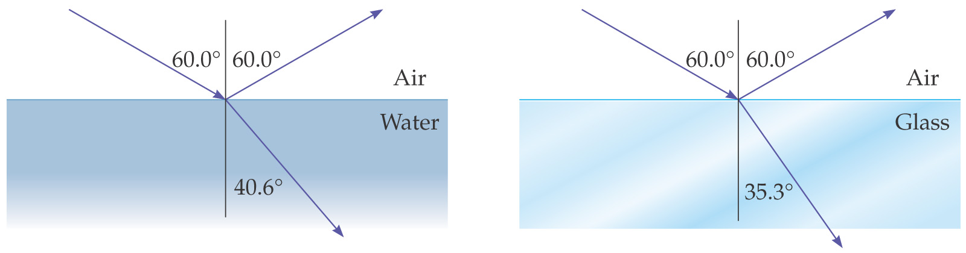
The Refraction of Light
We can now write the angle of refraction in terms of the index of refraction:

Slide 32
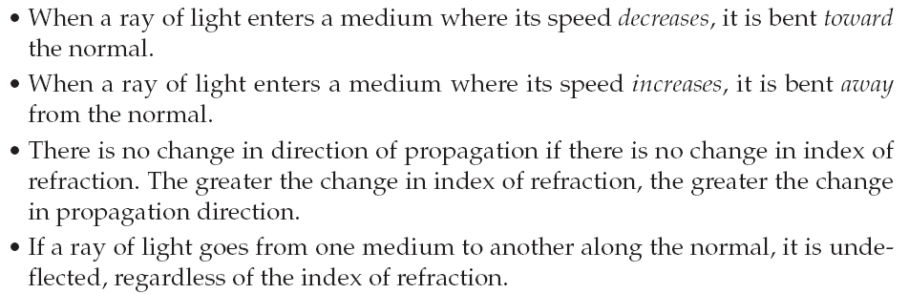
The Refraction of Light
Basic properties of refraction:

Slide 33
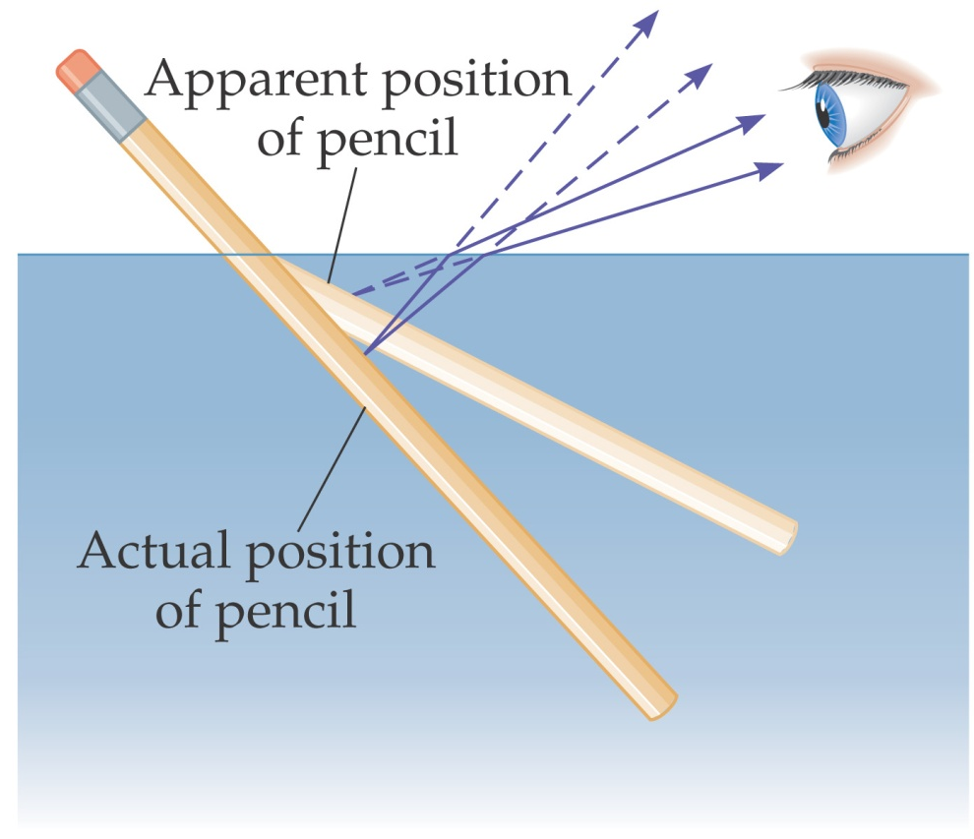
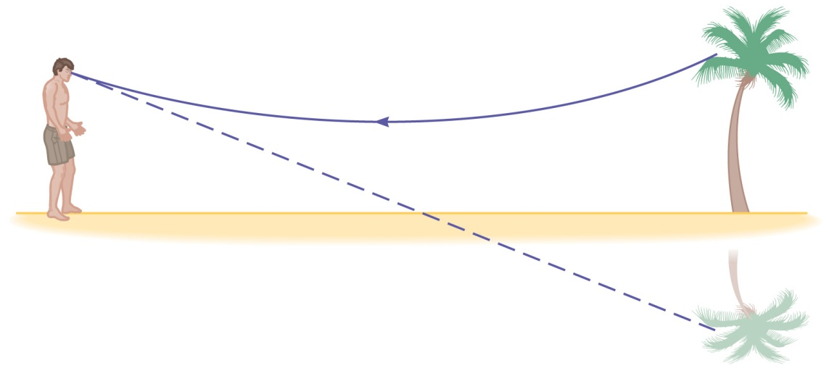
The Refraction of Light
Refraction can make objects immersed in water appear broken, and can create mirages.

Slide 34
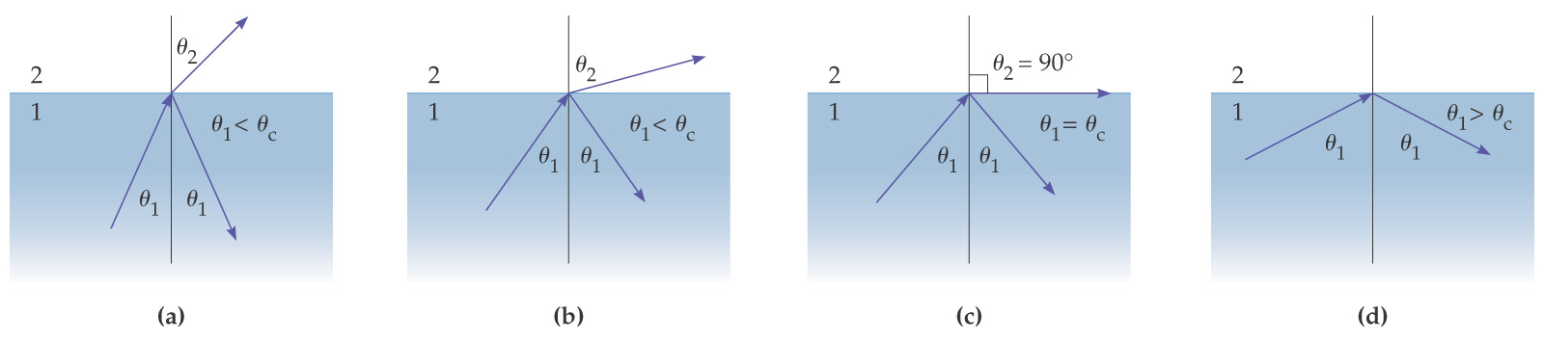
The Refraction of Light
If light enters a medium of lower index of refraction, it will be bent away from the normal. If the angle of incidence is large enough, the angle of refraction is 90°; at larger incident angles the light will be totally reflected.

Slide 35
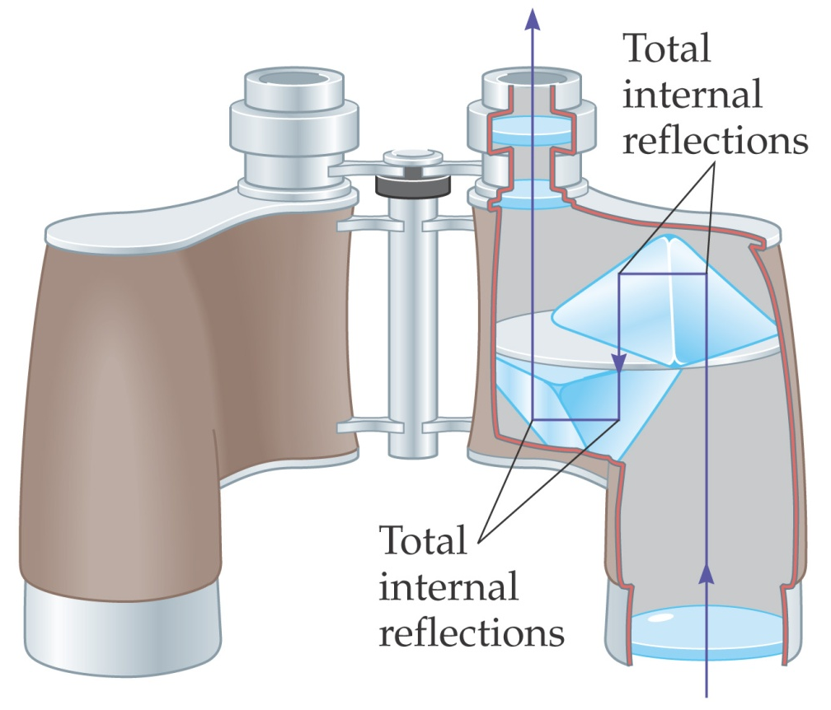
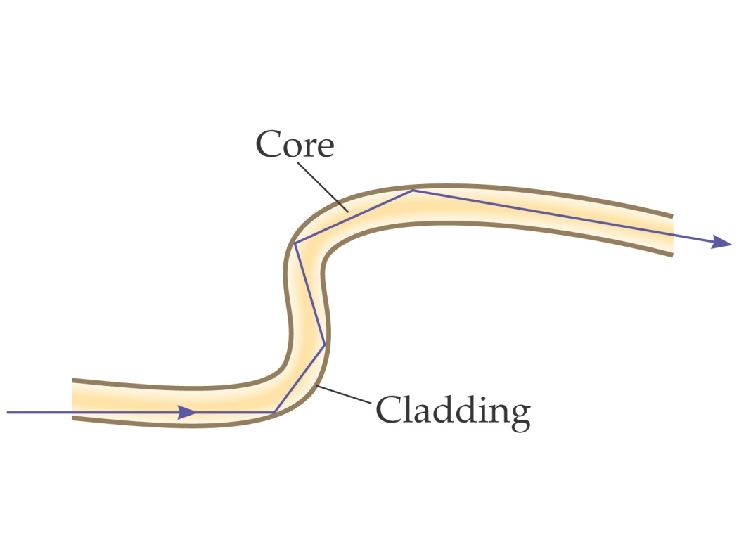
The Refraction of Light
This is called total internal reflection, and the incident angle at which the angle of refraction is 90° is called the critical angle, θ_{C}. Total internal reflection is used in some binoculars and in optical fibers.

Slide 36
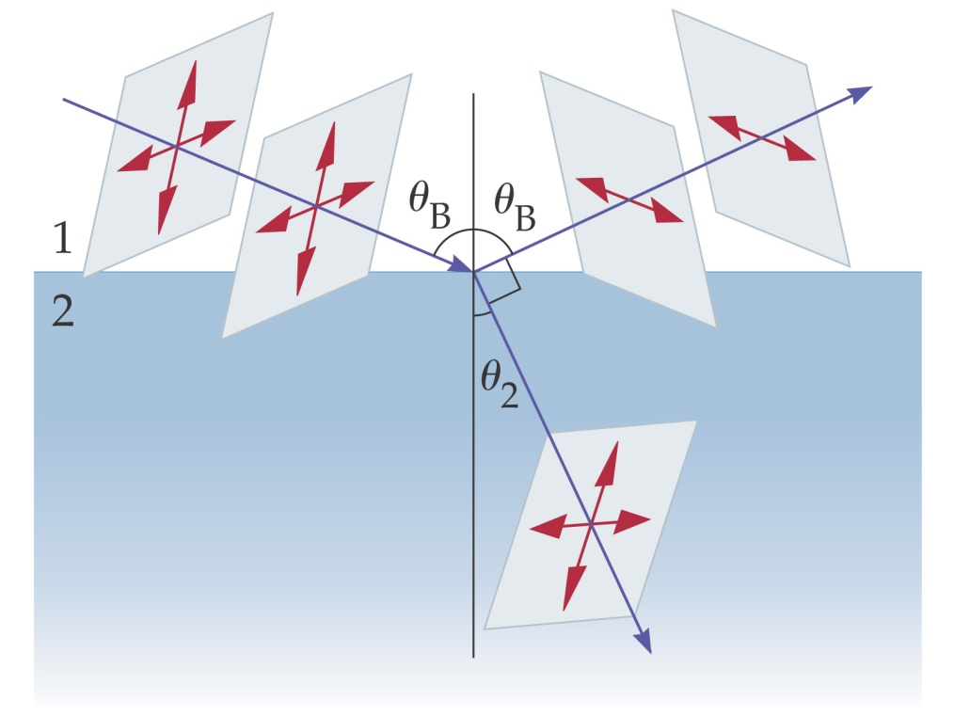
The Refraction of Light
There is a special angle called Brewster’s angle; light reflected at this angle is totally polarized.
Reflected light is completely polarized when the reflected and refracted beams are at right angles to one another. The direction of polarization is parallel to the reflecting surface.

Slide 37
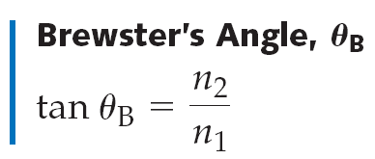
The Refraction of Light
Brewster’s angle can be calculated using the appropriate geometry:

Slide 38
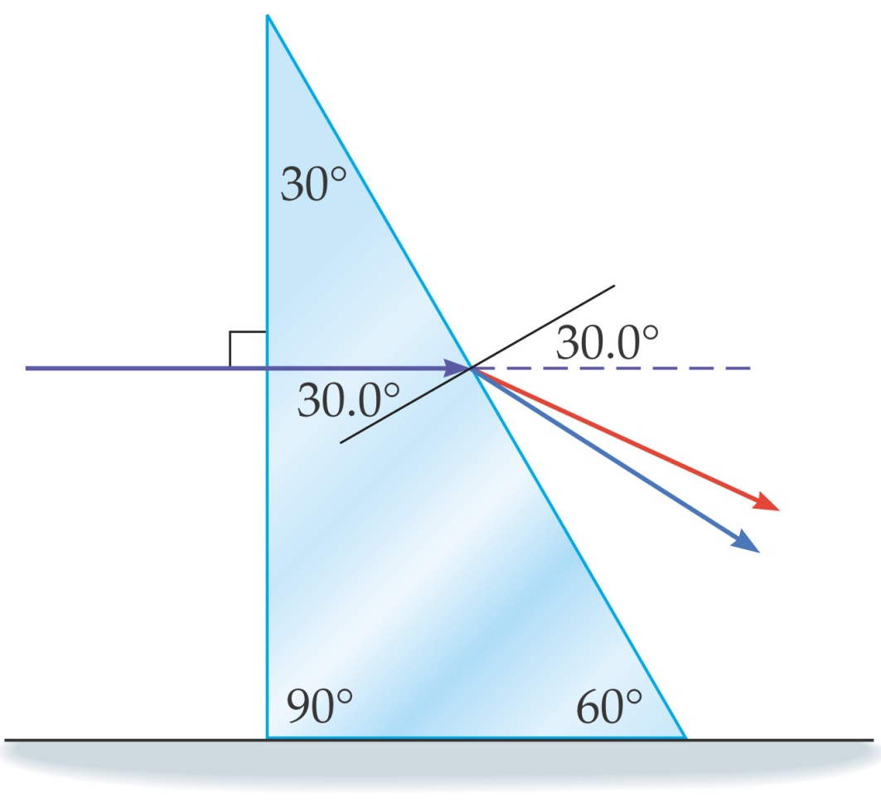
Dispersion and the Rainbow
The index of refraction varies slightly with the frequency of light; in general, the higher the frequency, the higher the index of refraction.
This means that refracted light is “spread out” in a rainbow of colors; this phenomenon is known as dispersion.

Slide 39
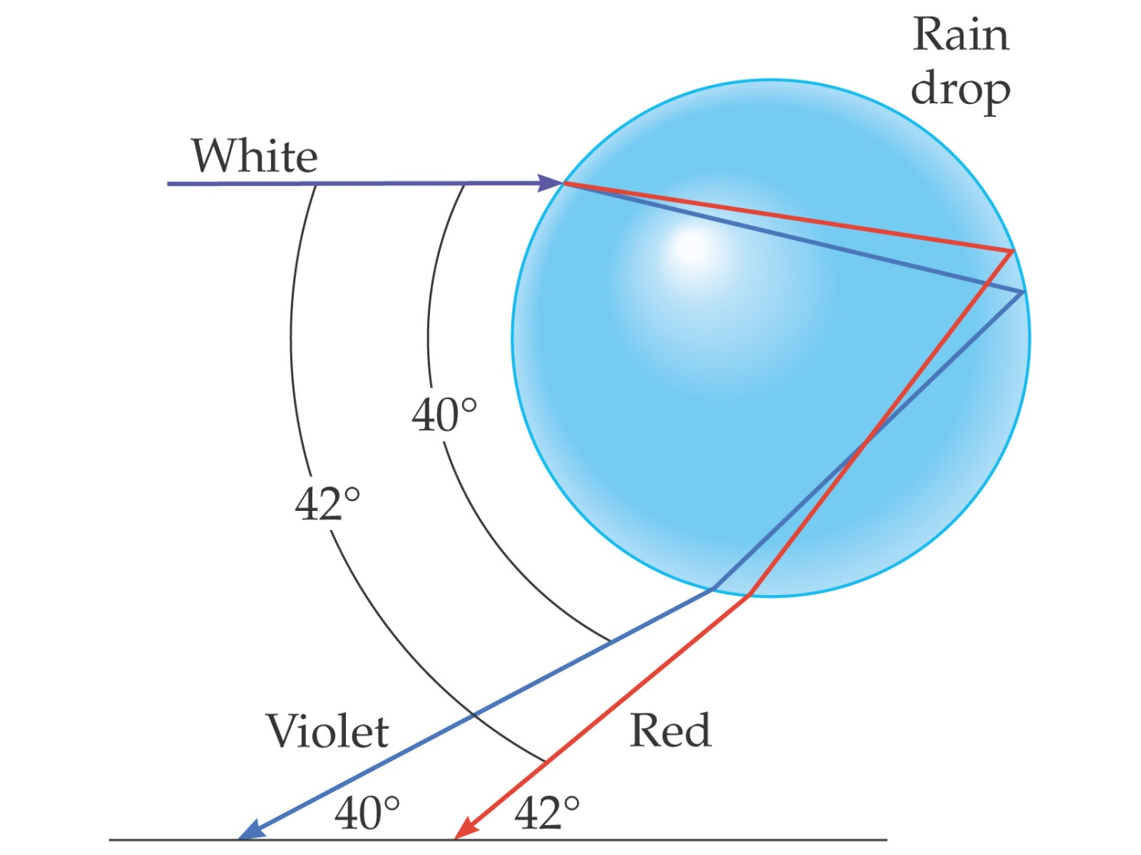
Dispersion and the Rainbow
Rainbows are created by the dispersion of light as it refracts in a rain drop.

Slide 40
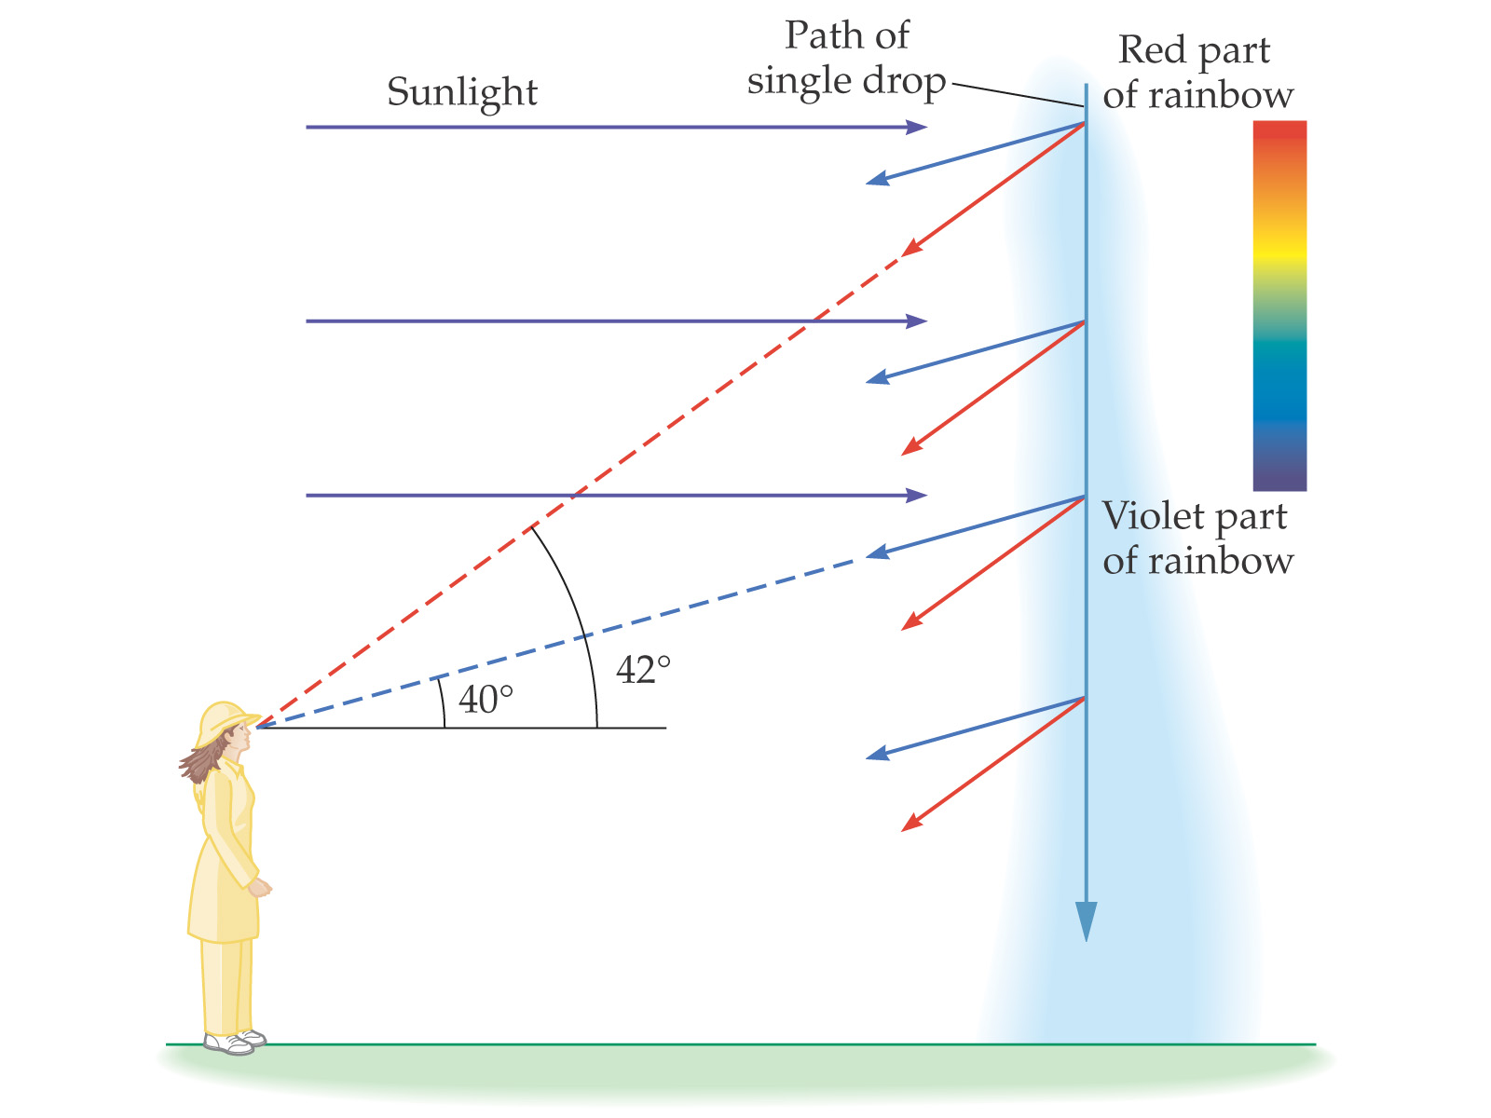
Dispersion and the Rainbow
As the drop falls, all the colors of the rainbow arrive at the eye.

Slide 41
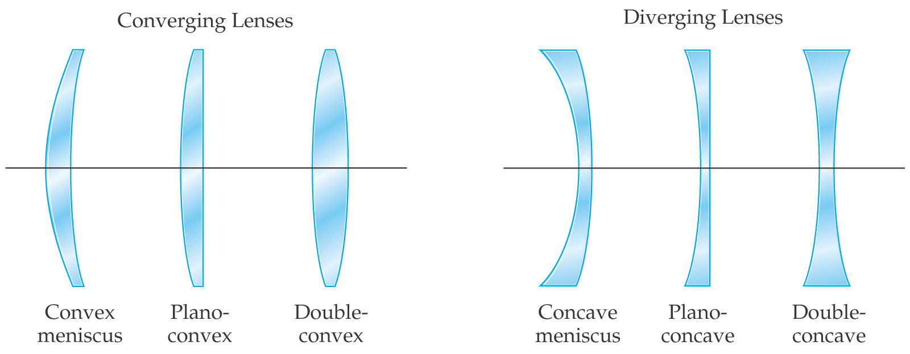
Ray Tracing for Lenses
Lenses are used to focus light and form images. There are a variety of possible types; we will consider only the symmetric ones, the double concave and the double convex.

Slide 42
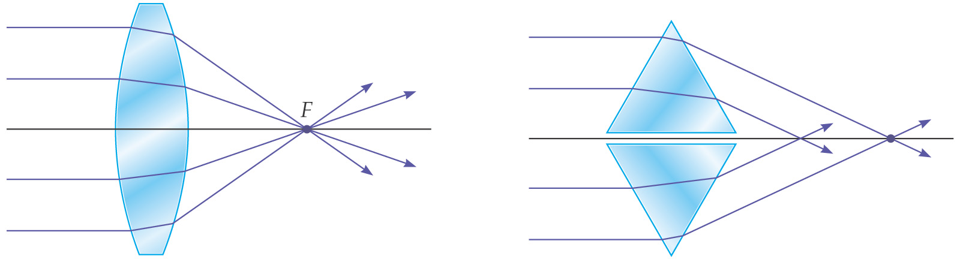
Ray Tracing for Lenses
If we think of a convex lens as consisting of prisms, we can see how light going through it converges at a focal point (assuming the lens is properly shaped).

Slide 43
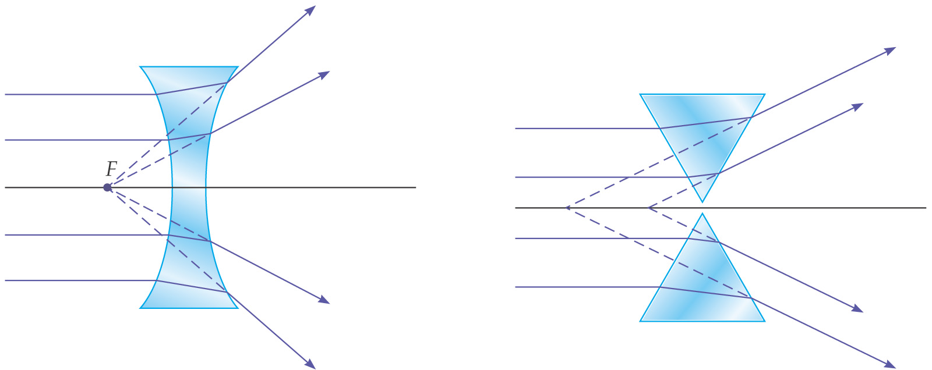
Ray Tracing for Lenses
A concave lens can also be modeled by prisms:

Slide 44
Ray Tracing for Lenses
The three principal rays for lenses are similar to those for mirrors:
The P ray—or parallel ray—approaches the lens parallel to its axis.
The F ray is drawn toward (concave) or through (convex) the focal point.
The midpoint ray (M ray) goes through the middle of the lens. Assuming the lens is thin enough, it will not be deflected. This is the thin-lens approximation.

Slide 45
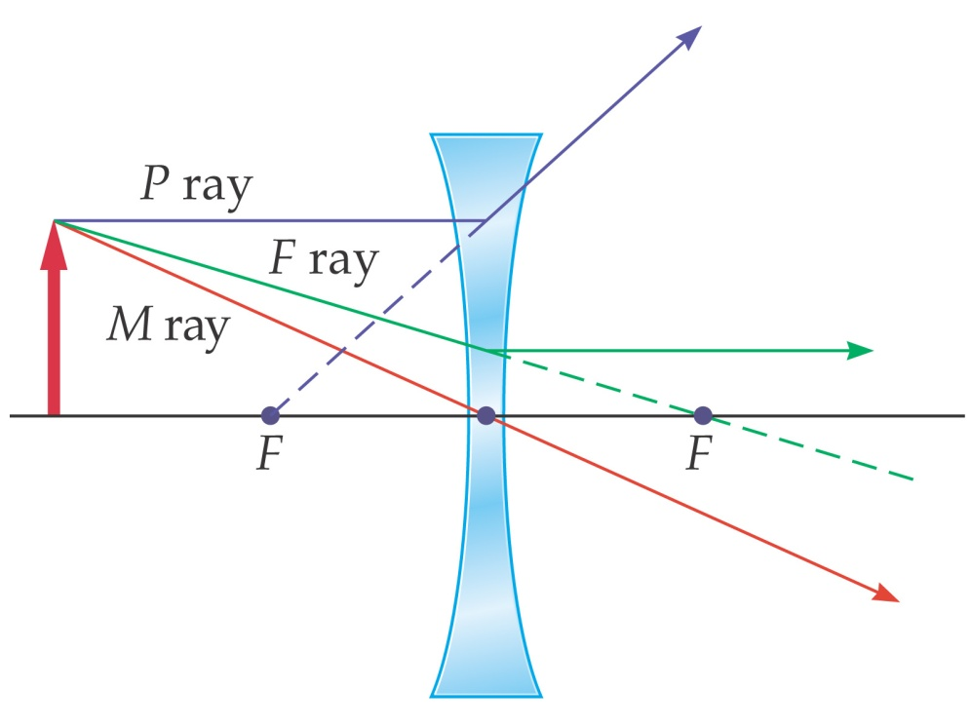
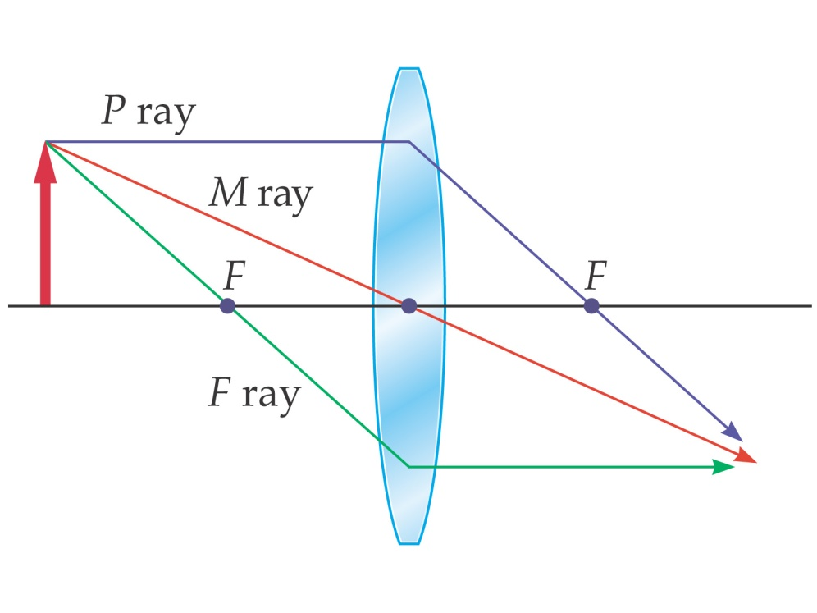
Ray Tracing for Lenses
These diagrams show the principal rays for both types of lenses:

Slide 46
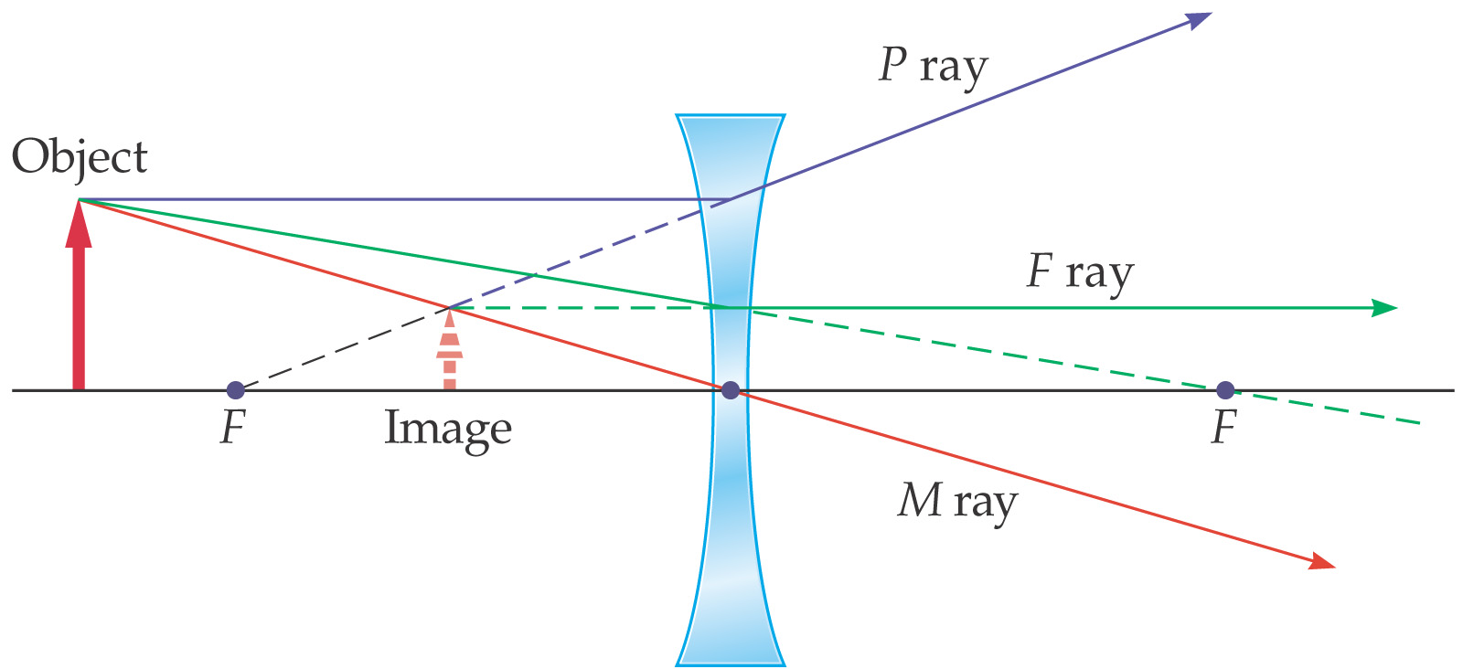
Ray Tracing for Lenses
As with mirrors, we use these principal rays to locate the image (the refracted parts of the ray):

Slide 47
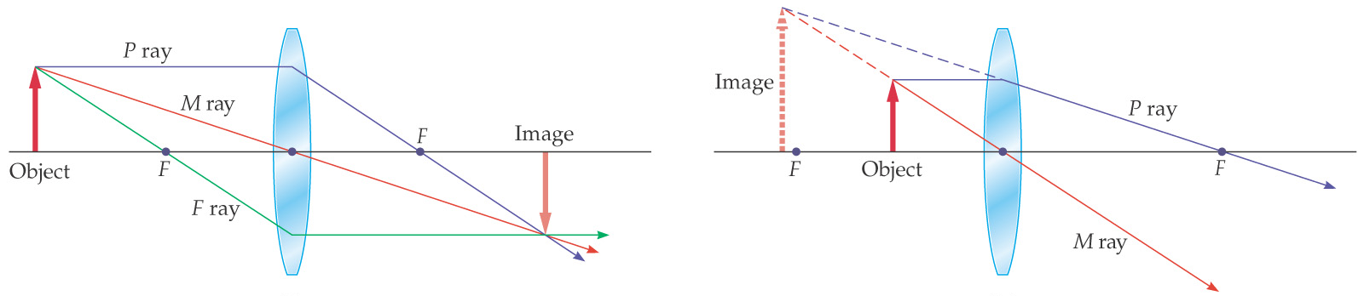
Ray Tracing for Lenses
The convex lens forms different image types depending on where the object is located with respect to the focal point:

Slide 48
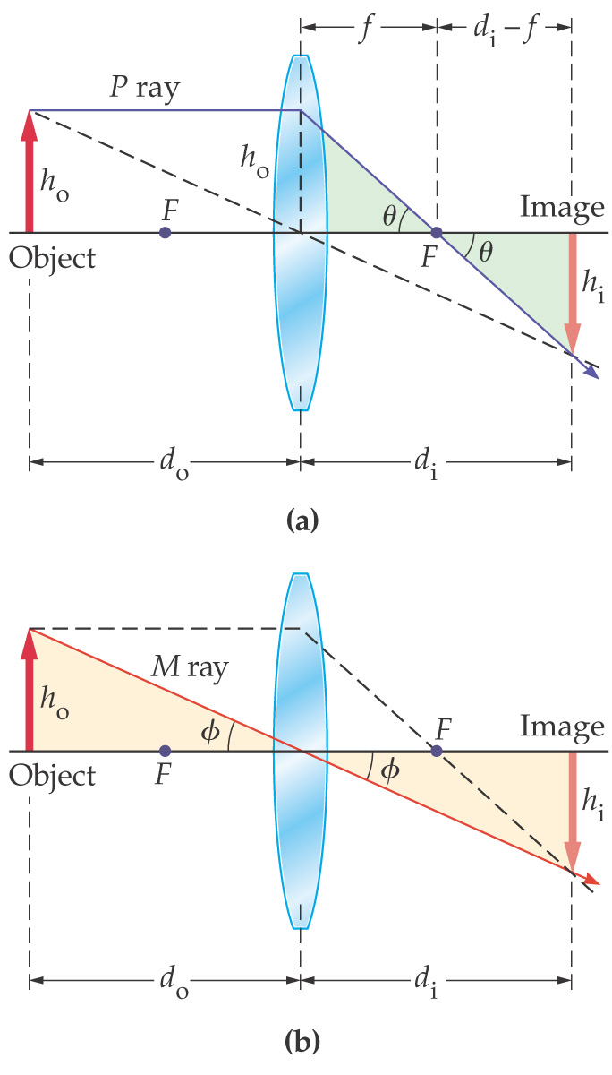
The Thin-Lens Equation
We derive the thin-lens equation in the same way we did the mirror equation, using these diagrams:

Slide 49
The Thin-Lens Equation
This gives us the thin-lens approximation, as well as the magnification:

Slide 50
The Thin-Lens Equation
Sign conventions for thin lenses:

Slide 51
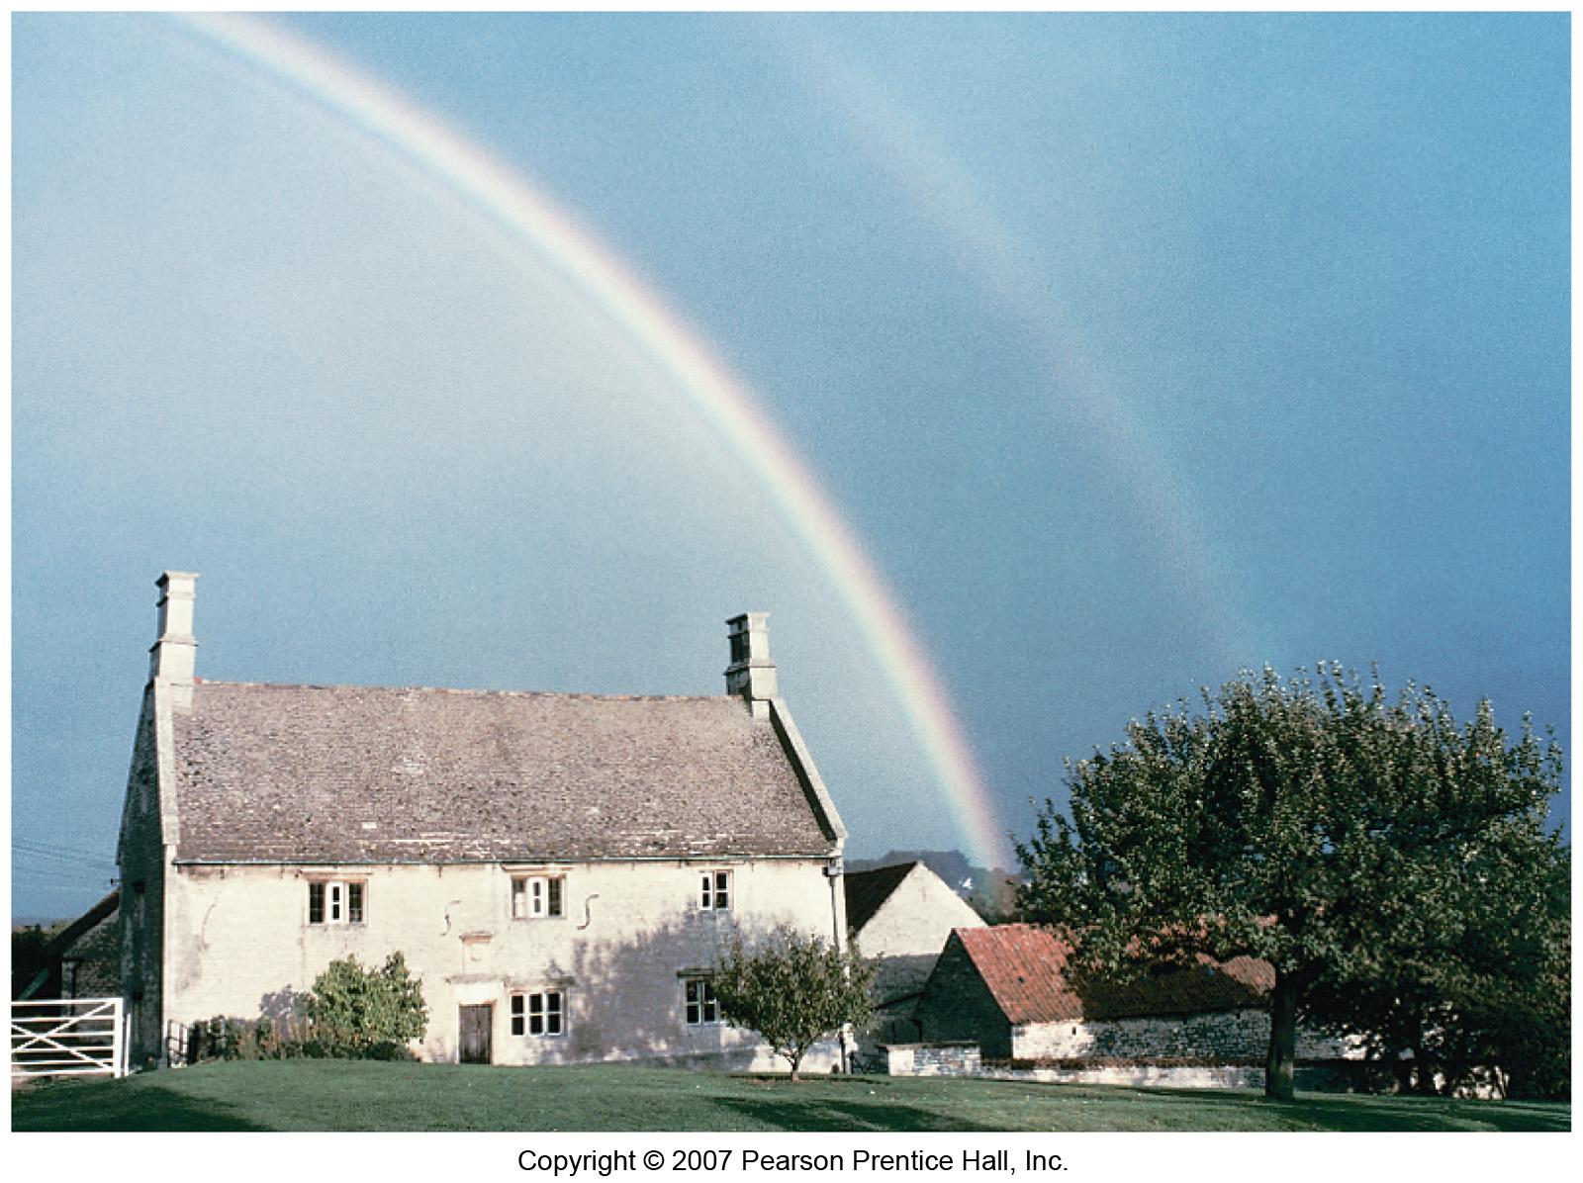
Dispersion and the Rainbow
Sometimes a faint secondary arc can be seen.

Slide 52
Summary
A wave front is a surface along which the wave phase is constant. Rays, perpendicular to the wave fronts, indicate the direction of propagation.
The angle of incidence equals the angle of reflection.
The image formed by a plane mirror is upright, but appears reversed left to right; appears to be the same distance behind the mirror as the object is in front of it; and is the same size as the object.

Slide 53

Summary Contd..
Spherical mirrors have spherical reflecting surfaces. A concave mirror is curved inward, and a convex one outward.
Focal length of a convex mirror:
Focal length of a concave mirror:
An image is real if light passes through it, virtual if it does not.
Mirror equation:

Slide 54
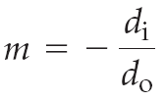
Summary Contd…
Magnification:
Refraction is the change in direction of light due to a change in speed.
The index of refraction gives the speed of light in a medium:

Slide 55

Summary Contd…
Snell’s law:
Light entering a medium of higher n is bent towards the normal; light entering a medium of lower n is bent away from the normal.
When light enters a medium of lower n, there is a critical angle beyond which the light will be totally reflected.

Slide 56
Summary Contd….
At Brewster’s angle, the reflected light is totally polarized:
A lens uses refraction to bend light and form images.
Thin-lens equation:

Slide 57
Summary Contd….
Magnification:
The index of refraction varies with frequency; different frequencies of light are bent different amounts. This is called dispersion.

Slide 58
The magnification of an object = -3.0.
Describe the image.
Inverted and magnified
Inverted and reduced
Upright and magnified
Upright and reduced

Slide 59
The magnification of an object = 0.80
Describe the image.
Inverted and magnified
Inverted and reduced
Upright and magnified
Upright and reduced

Slide 60
The focal length of a mirror is -.4cm.
What type of mirror is it?
Concave
Convex
Plane
Cannot be determined

Slide 61
A virtual image is always produced.
What type of mirror is it?
Concave
Convex
Plane
Cannot be determined

Slide 62
The image distance is -5cm. Describe the image with as much description as possible.
Real
Virtual
Real and inverted
Virtual and inverted
Real, inverted, and reduced
Virtual, inverted, and magnified.

Slide 63
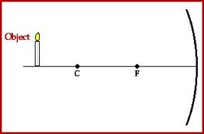
What type of mirror is the following?
Convex
Concave
Plane
Unable to be determined

Slide 64
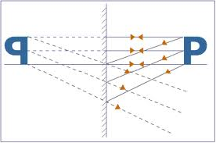
What type of mirror is the following?
Convex
Concave
Plane
Unable to be determined

Slide 65
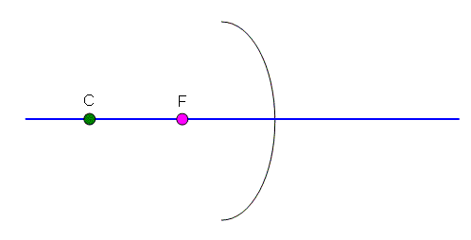
What type of mirror is the following?
Convex
Concave
Plane
Unable to be determined

Slide 66
What type of image is formed?
Real and Upright
Virtual and Upright
Real and Inverted
Virtual and Inverted

